Slide 1
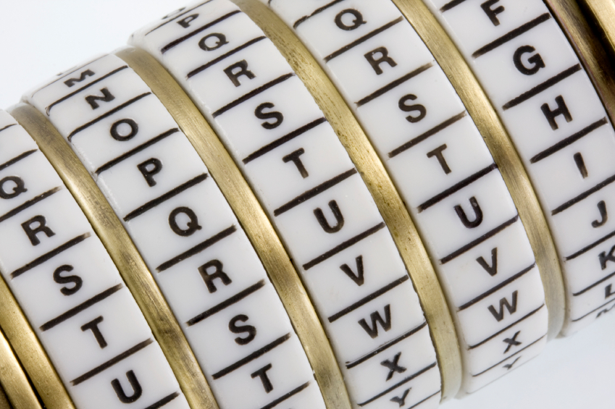
The Elements of Cryptography
Chapter 3

Slide 2
Leaning Objectives
By the end of this chapter, the student should be able to discuss the following:
The concept of cryptography
Symmetric key encryption for confidentiality
Cryptographic systems
The negotiation stage
Initial authentication, including MS-CHAP
Keying, including public key encryption for confidentiality and Diffie-Hellman key agreement
Electronic signatures
Public key encryption for authentication
Hash functions

Slide 3




Cryptography
Cryptography is the use of mathematical operations to protect messages traveling between parties or stored on a computer
Confidentiality means that someone intercepting your communications cannot read them
???

Slide 4
Goals of Cryptography
Confidentiality is only one cryptographic protection
Authentication means proving one’s identity to another so they can trust you more
Integrity means that the message cannot be changed or, if it is change, that this change will be detected

Slide 5
Cryptography
Cryptography
“The act or art of writing in code or secret characters; also, secret characters, codes or ciphers, or messages written in a secret code” – Webster’s dictionary
Cryptanalysis
Encryption
Decryption
Plaintext
Cipher
Ciphertext

Slide 6
Cryptography
Encryption for confidentiality needs a cipher (mathematical method) to encrypt and decrypt
The cipher cannot be kept secret
The two parties using the cipher also need to know a secret key or keys
A key is merely a long stream of bits (1s and 0s)
The key or keys must be kept secret
Cryptanalysts attempt to crack (find) the key

Slide 7
3-1: Symmetric Key Encryption for Confidentiality

Slide 8
Types of Ciphers
Substitution Ciphers
Substitute one letter (or bit) for another in each place
The cipher we saw in Figure 3-2 is a substitution cipher
Transposition (permutation) Ciphers
Transposition ciphers do not change individual letters or bits, but they change their order
Hybrid: Most real ciphers use both substitution and transposition

Slide 9
Arbitrary Substitution
Key: mapping function
Can break w/ character frequency analysis
See example
Plaintext | Key | Ciphertext
n | 4 | r
o | 8 | w
w | 15 | l
i | 16 | …
s | 23 | …
t | 16 | …
h | 3 | …
e | 9 | …
t | 12 | …
i | 20 | …
m | 6 | …
e | 25 | …

Slide 10
Substitution Exercise
Plaintext:
ONE -> 1001111 1001110 1000101
Key (TWO): 1010100 1010111 1001111
Cipher: XOR operation
Ciphertext:
???

Slide 11
Transposition Cipher
Plaintext: nowisthet
Ciphertext: ?????????
Easily breakable using computer
 | Key (Part 1)
Key (Part 2) | 1 | 3 | 2
2 | n | o | w
3 | i | s | t
1 | h | e | t
Key = 132 231

Slide 12
Ciphers versus Codes
Ciphers can encrypt any message expressed in binary (1s and 0s)
This flexibility and the speed of computing makes this ciphers dominant for encryption today
Codes are more specialized
They substitute one thing for another
Usually a word for another word or a number for a word
Codes are good for humans and may be included in messages sent via encipherment

Slide 13
Japanese Naval Operational Code JN-25
Message | Code
From | 17434
Akagi | 63717
To | 83971
Truk | 11131
STOP | 34058
ETA | 53764
6 PM | 73104
STOP | 26733
Require | 29798
B | 72135
N | 54678
STOP | 61552
Transmitted:
174346371783971…

Slide 14
Cryptographic Systems
Symmetric encryption
Most basic and well-known
Uses one key
Has historical roots
Asymmetric encryption
Uses public/private key pair
Hash functions
One-way transformation

Slide 15
Symmetric-key Cryptography
Relies on secret, shared key
Provides confidentiality
Computationally secure: the time that is necessary to decode the key is so large
Two types
Stream ciphers
Block ciphers
Examples:
Data Encryption Standard (DES), Triple DES
Advanced Encryption Standard (AES)
Blowfish
Internal Data Encryption Algorithm (IDEA)
* Cole, 2009

Slide 16
Block Ciphers
Block Ciphers
Block ciphers encrypt plaintext in fixed-length blocks (e.g., 64 or 128 bits)
Example:
DES: 64 bit block and a 56-bit key
AES: 128 bit block and 128, 192, 256-bit key
RSA and Diffie-Hellman: Variable block sizes
Attacks
If the same blocks generate the same ciphertext, encryption can be broken: if electronic code book mode (ECB) used
Use different mode: cipher block chaining (CBC), cipher feedback (CFB), output feedback (OFB)

Slide 17
Stream Ciphers
Stream Ciphers
Encrypt plaintext one byte or one bit at a time
Useful for real-time video and audio
Example Stream Ciphers
A5: encrypt GSM communications
RC4: from RSA
Block Ciphers vs. Stream Ciphers
Block ciphers more efficient for computers
Stream ciphers easier for humans to do by hand
* Content: ech-faq.com

Slide 18
Key Length and Exhaustive Search Time
Key Length in Bits | Number of Possible Keys
1 | 2
2 | 4
4 | 16
8 | 256
16 | 65,536
40 | 1,099,511,627,776
56 | 72,057,594,037,927,900
112 | 5,192,296,858,534,830,000,000,000,000,000,000
112 | 5.1923E+33
168 | 3.74144E+50
256 | 1.15792E+77
512 | 1.3408E+154
Each extra bit
doubles the number of keys
Shaded keys are
Strong symmetric keys (>=100 bits)
© Panko, 2010, Prentice-Hall

Slide 19
Symmetric Key Encryption Ciphers
 | RC4 | DES | 3DES | AES
Key Length (bits) | 40 bits or more | 56 | 112 or 168 | 128, 192, or 256
Key Strength | Very weak at 40 bits | Weak | Strong | Strong
Processing Requirements | Low | Moderate | High | Low
RAM Requirements | Low | Moderate | Moderate | Low
Remarks | Can uses keys of variable length | Created in the 1970s | Applies DES three times with two or three different DES keys | Today’s gold standard for symmetric key encryption
© Panko, 2010, Prentice-Hall

Slide 20
Data Encryption Standard (DES)
Released in 1977
A block cipher that uses shared secret encryption
A symmetric-key algorithm, 64-bit block cipher (56-bit key + 8 redundant bits)
Now considered to be insecure – the key size being too small
3DES preferred
Cracking DES by O’Reilly

Slide 21
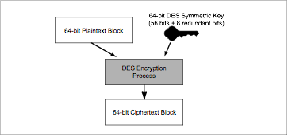
3-7: DES Block Encryption
The DES cipher encrypts messages 64 bits at a time.
The DES cipher (in codebook mode) needs two inputs.

Slide 22
Advanced Encryption Standard (AES)
NIST announced the initiation of an effort in 1997
Five finalists in 1999: MARS, RC6, Rijndael, Serpent, and Twofish.
On October 2, 2000, NIST selected Rijndael as the proposed AES
Became effective as a Federal government standard in 2002

Slide 23
Cryptography in Home Entertainment: A Look at Content Scrambling in DVD
http://www.math.ucsd.edu/~crypto/Projects/MarkBarry/index.htm
http://en.wikipedia.org/wiki/Content_Scramble_System
Impossible to keep a cipher secret

Slide 24
Sharing Keys in Symmetric Encryption
The key must be shared with both parties
Authentication is not ensured
Key agreement protocol can be used
Diffie-Hellman algorithm
ElGamal

Slide 25
Diffie-Hellman Algorithm
Alice & Bob exchanges a prime (P) and a generator (G), where P>G, in clear text
Select P=7, G=4
Step 1:
Alice generates a random number (X_{a}=2)
Bob generates a random number (X_{b}=3)
Step 2:
Y_{a} = G^{Xa} (mod P) = 4² mod 7 = 2
Y_{b} = G^{Xb} (mod P) = 4³ mod 7 = 1
Step 3:
Alice receives Y_{b} = 1 in clear text
Bob receives Y_{a} = 2 in clear text
Step 4:
Secret key for Alice = Y_{b}^{Xa} (mod P) = 1² mod 7 = 1
Secret key for Bob = Y_{a}^{Xb} (mod P) = 2³ mod 7 = 1

Slide 26
3-8: Cryptographic System Stages
Cryptographic Systems
Encryption for confidentiality is only one cryptographic protection
Individual users and corporations cannot be expected to master these many aspects of cryptography
Consequently, crypto protections are organized into complete cryptographic systems that provide a broad set of cryptographic protection

Slide 27
3-8: Cryptographic System Stages
Cryptographic Systems
Two parties first agree upon a particular cryptographic system to use
Each cryptographic system dialogue begins with three brief hand-shaking stages
The two parties then engage in cryptographically protected communication
This ongoing communication stage usually constitutes nearly all of the dialogue

Slide 28
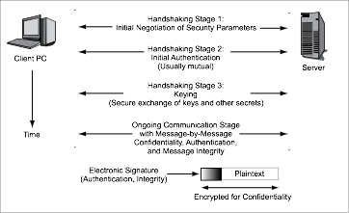
3-8: Cryptographic System Stages
Time

Slide 29
3-8: Cryptographic System Stages

Slide 30
Stage 1: Selecting Security Methods and Parameters
Selecting methods and parameters
Authentication
Keying (the secure exchange of secrets)
Ongoing communication

Slide 31
3-9: Selected SSL/TLS Cipher Suites
Cipher Suite | Key Negotiation | Digital Signature Method | Symmetric Key Encryption Method | Hashing Method for HMAC | Strength
NULL_WITH_NULL_NULL | None | None | None | None | None
RSA_EXPORT_WITH_ RC4_40_MD5 | RSA export strength (40 bits) | RSA export strength (40 bits) | RC4 (40-bit key) | MD5 | Weak
RSA_WITH_DES_CBC_ SHA | RSA | RSA | DES_CBC | SHA-1 | Stronger but not very strong
DH_DSS_WITH_3DES_ EDE_CBC_SHA | Diffie-Hellman | Digital Signature Standard | 3DES_ EDE_CBC | SHA-1 | Strong
RSA_WITH_AES_256_CBC_SHA256 | RSA | RSA | AES 256 bits | SHA-256 | Very strong

Slide 32
Cipher Suite Policies
Depend on risk-based policies
Risk = Vulnerability X Threat
Vulnerability: a weakness in a system that can be attacked
Threat: the frequency of potentially adverse events

Slide 33
Stage 2: Authentication
Selecting methods and parameters
Authentication
Keying (the secure exchange of secrets)
Ongoing communication

Slide 34



3-10: Authentication: Supplicant, Verifier, and Credentials
Supplicant:
Wishes to prove its identity
Credentials
Proofs of identity (password, etc.)
Verifier:
Tests the credentials, accepts or rejects the supplicant

Slide 35
3-11: Hashing
Hashing
A hashing algorithm is applied to a bit string of any length
The result of the calculation is called the hash
For a given hashing algorithm, all hashes are the same short length
Hashing
Algorithm
Bit string of any length
Hash: bit string of small fixed length

Slide 36
3-11: Hashing
Hashing versus Encryption
Characteristic | Encryption | Hashing
Result length | About the same length as the plaintext | Short fixed length regardless of message length
Reversible? | Yes. Decryption | No. There is no way to get from the short hash back to the long original message

Slide 37
3-11: Hashing
Hashing Algorithms
MD5 (128-bit hashes)
SHA-1 (160-bit hashes)
SHA-224, SHA-256, SHA-384, and SHA-512 (name gives hash length in bits)
Note: MD5 and SHA-1 should not be used because they have been shown to be insecure

Slide 38
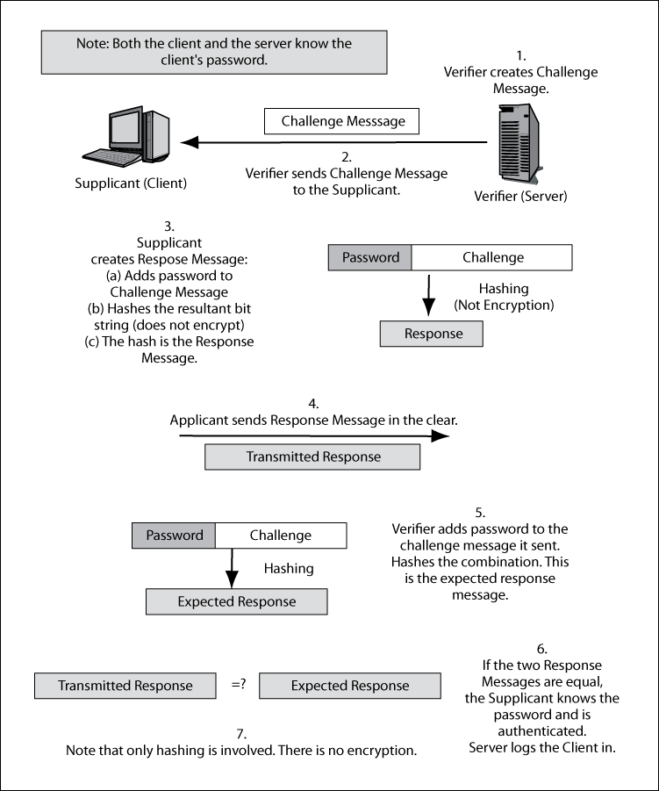
3-12: MS-CHAP Challenge-Response Authentication Protocol
Copyright Pearson Prentice-Hall 2009

Slide 39
3-12: MS-CHAP Challenge-Response Authentication Protocol
Supplicant sends Response Message in the clear
(without encryption)
Transmitted Response Message

Slide 40
3-12: MS-CHAP Challenge-Response Authentication Protocol

Slide 41
Stage 3: Keying
Selecting methods and parameters
Authentication
Keying (the secure exchange of secrets)
Ongoing communication

Slide 42
3-13: Public Key Encryption for Confidentiality
There are two types of ciphers used for confidentiality
In symmetric key encryption for confidentiality, the two sides use the same key
For each dialogue (session), a new symmetric key is generated: the symmetric session key
In public key encryption, each party has a public key and a private key that are never changed
A person’s public key is available to anyone
A person keeps his or her private key secret

Slide 43
Asymmetric Encryption
Uses two keys - slow
Used to share secret keys
Public key is distributed with digital certificates
Ciphers:
RSA (Rivest, Shamir and Adleman)
ECC (Elliptic Curve Crypto)

Slide 44
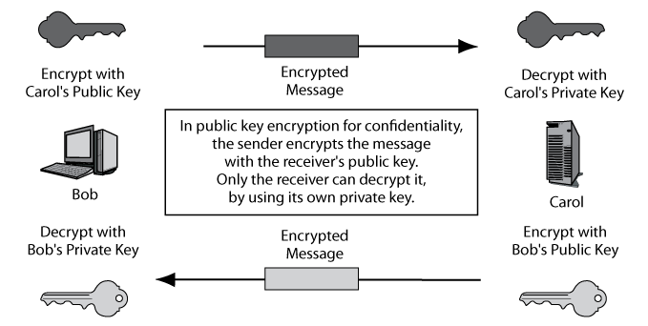
3-13: Public Key Encryption for Confidentiality

Slide 45
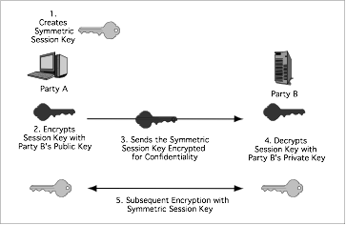
3-14: Public Key Keying for Symmetric Session Keys

Slide 46
3-15: Keying Using Diffie-Hellman Key Agreement
The two parties exchange parameters p and g
Each uses a number that is never shared explicitly to compute a second number
Each sends the other their second number
Each does another computation on the second computed number
Both get the third number, which is the key
All of this communication is sent in the clear

Slide 47
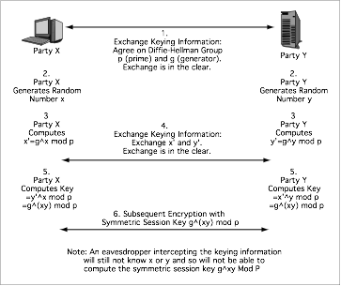
3-15: Keying Using Diffie-Hellman Key Agreement
The gory details

Slide 48
Stage 4: Ongoing Communication
Selecting methods and parameters
Authentication
Keying (the secure exchange of secrets)
Ongoing communication

Slide 49
Ongoing Communication
Consumes nearly all of the dialogues
Message-by-Message Encryption
Nearly always uses symmetric key encryption
Already covered
Public key encryption is too inefficient
Message-by-Message Authentication
Digital signatures
Key-hashed Message authentication codes (HMACs)
Also provide message-by-message integrity

Slide 50
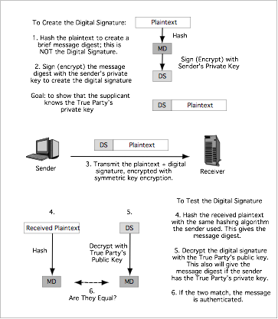
3-16: Digital Signature for Message-by-Message Authentication

Slide 51
3-16: Digital Signature for Message-by-Message Authentication
Encryption is done to protect the plaintext
It is not needed for message-by-message authentication

Slide 52
3-16: Digital Signature for Message-by-Message Authentication

Slide 53
3-17: Public Key Encryption for Confidentiality and Authentication
Encryption Goal | Sender Encrypts with | Receiver Decrypts with
Public Key Encryption for Confidentiality | The receiver’s public key | The receiver’s private key
Public Key Encryption for Authentication | The sender’s private key | The True Party’s public key (not the sender’s public key)
Point of frequent confusion

Slide 54
Finding the True Party’s Public Key
Cannot use the sender’s public key
It would always “validate” the sender’s digital signature
Normally requires a digital certificate
File provided by a certificate authority (CA)
The certificate authority must be trustworthy
Digital certificate provides the subject’s (True Party’s) name and public key
Don’t confuse digital signatures and the digital certificates used to test digital signatures!

Slide 55
3-18: X.509 Digital Certificate Fields
Field | Description
Version Number | Version number of the X.509 standard. Most certificates follow Version 3. Different versions have different fields. This figure reflects the Version 3 standard.
Issuer | Name of the Certificate Authority (CA).
Serial Number | Unique serial number for the certificate, set by the CA.
Subject (True Party) | The name of the person, organization, computer, or program to which the certificate has been issued. This is the true party.
Public Key | The public key of the subject (the true party).
Public Key Algorithm | The algorithm the subject uses to sign messages with digital signatures.
Serial number allows the receiver to check if the digital certificate has been revoked by the CA
Certificate provides the True Party’s public key

Slide 56
3-18: X.509 Digital Certificate Fields
Field | Description
Digital Signature | The digital signature of the certificate, signed by the CA with the CA’s own private key. For testing certificate authentication and integrity. User must know the CA’s public key independently.
Signature Algorithm Identifier | The digital signature algorithm the CA uses to sign its certificates.
Other Fields | …
The CA signs the cert with its own private key so that the cert’s validity can be checked for alterations.

Slide 57
3-19: Verifying the Digital Certificate
Testing the Digital Signature
The digital certificate has a digital signature of its own
Signed with the Certificate Authority’s (CA’s) private key
Must be tested with the CA’s well-known public key
If the test works, the certificate is authentic and unmodified

Slide 58
3-19: Verifying the Digital Certificate
Checking the Valid Period
Certificate is valid only during the valid period in the digital certificate (not shown in the figure)
If the current time is not within the valid period, reject the digital certificate

Slide 59
3-19: Verifying the Digital Certificate
Checking for Revocation
Certificates may be revoked for improper behavior or other reasons
Revocation must be tested
Cannot be done by looking at fields within the certificate
Receiver must check with the CA

Slide 60
3-19: Verifying the Digital Certificate
Checking for Revocation
Verifier may download the entire certificate revocation list from the CA
See if the serial number is on the certificate revocation list
If so, do not accept the certificate
Or, the verifier may send a query to the CA
Requires the CA to support the Online Certificate Status Protocol

Slide 61
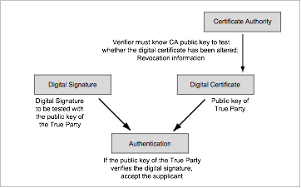
3-20: Digital Signature and Digital Certificate in Authentication (overview)

Slide 62
Message-by-Message Authentication
Also Brings Message Integrity
If the message has been altered, the authentication method will fail automatically
Digital Signature Authentication
Uses public key encryption for authentication
Very strong but expensive
Key-Hashed Message Authentication Codes
An alternate authentication method using hashing
Much less expensive than digital signature authentication
Much more widely used

Slide 63
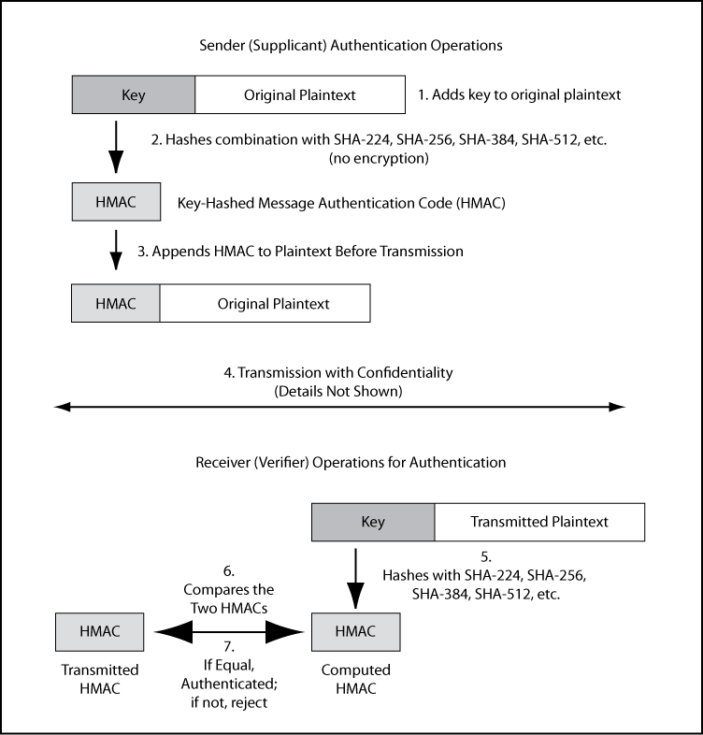
3-21: Key-Hashed Message Authentication Code (HMAC)

Slide 64
3-21: Key-Hashed Message Authentication Code (HMAC)
As in the case of digital signatures, confidentiality is done to protect the plaintext.
It is not needed for authentication and has nothing to do with authentication.

Slide 65
3-21: Key-Hashed Message Authentication Code (HMAC)

Slide 66
Nonrepudiation
Nonrepudiation means that the sender cannot deny that he or she sent a message
With digital signatures, the sender must use his or her private key
It is difficult to repudiate that you sent something if you use your private key
With HMACs, both parties know the key used to create the HMAC
The sender can repudiate the message, claiming that the receiver created it

Slide 67
Nonrepudiation
However, packet-level nonrepudiation is unimportant in most cases
The application message—an e-mail message, a contract, etc., is the important thing
If the application layer message has its own digital signature, you have nonrepudiation for the application message, even if you use HMACs at the internet layer for packet authentication

Slide 68
3-22: Replay Attacks and Defenses
Replay Attacks
Capture and then retransmit an encrypted message later
May have a desired effect
Even if the attacker cannot read the message

Slide 69
3-22: Replay Attacks and Defenses
Thwarting Replay Attacks
Time stamps to ensure freshness of each message
Sequence numbers so that repeated messages can be detected
Nonces
Unique randomly generated number placed in each request message
Reflected in the response message
If a request arrives with a previously used nonce, it is rejected

Slide 70
3-23: Quantum Security
Quantum Mechanics
Describes the behavior of fundamental particles
Complex and even weird results

Slide 71
3-23: Quantum Security
Quantum Key Distribution
Transmits a very long key—as long as the message
This is a one-time key that will not be used again
A one-time key as long as a message cannot be cracked by cryptanalysis
If an interceptor reads part of the key in transit, this will be immediately apparent to the sender and receiver

Slide 72
3-23: Quantum Security
Quantum Key Cracking
Tests many keys simultaneously
If quantum key cracking becomes capable of working on long keys, today’s strong key lengths will offer no protection

Slide 73
3-24: Core Cryptographic Processes
 | Confidentiality | Authentication
Symmetric Key Encryption | Applicable. Sender encrypts with key shared with the receiver. | Not applicable.
Public Key Encryption | Applicable. Sender encrypts with receiver’s public key. Receiver decrypts with the receiver’s own private key. | Applicable. Sender (supplicant) encrypts with own private key. Receiver (verifier) decrypts with the public key of the true party, usually obtained from the true party’s digital certificate.
Hashing | Not applicable. | Applicable. Used in MS-CHAP for initial authentication and in HMACs for message-by-message authentication.
Copyright Pearson Prentice-Hall 2009

Slide 74
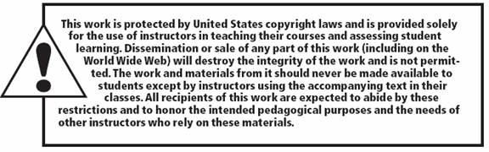
All rights reserved. No part of this publication may be reproduced, stored in a retrieval system, or transmitted, in any form or by any means, electronic, mechanical, photocopying, recording, or otherwise, without the prior written permission of the publisher. Printed in the United States of America.
Copyright © 2010 Pearson Education, Inc.
Publishing as Prentice Hall

